Slide 1

Selections
TUIT
C++ Programming, Fall 2016
Lecture #3
I – part

Slide 2
TUIT
Roadmap
Last week we covered
Elementary Programming
This week we will learn
Introduction
The bool Data Type
if Statements
Two-Way if – else Statements
Nested if and Multi-Way if – else Statements
Common Errors and Pitfalls

Slide 3
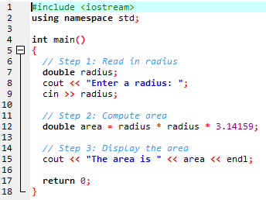
TUIT
Introduction
The program can decide which statements to execute based on a condition.
If you enter a negative value for radius in ComputeAreaWithConsoleInput.cpp the program displays an invalid result

Slide 4
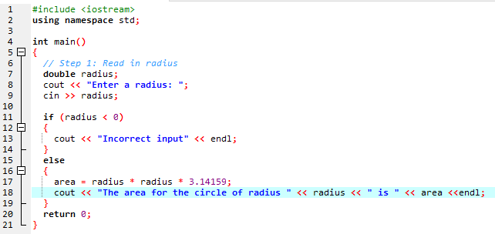
TUIT
Introduction
How can you deal with situation?
Like high-level programming languages, C++ provides selection statements: statements that let you choose actions with alternative courses.

Slide 5
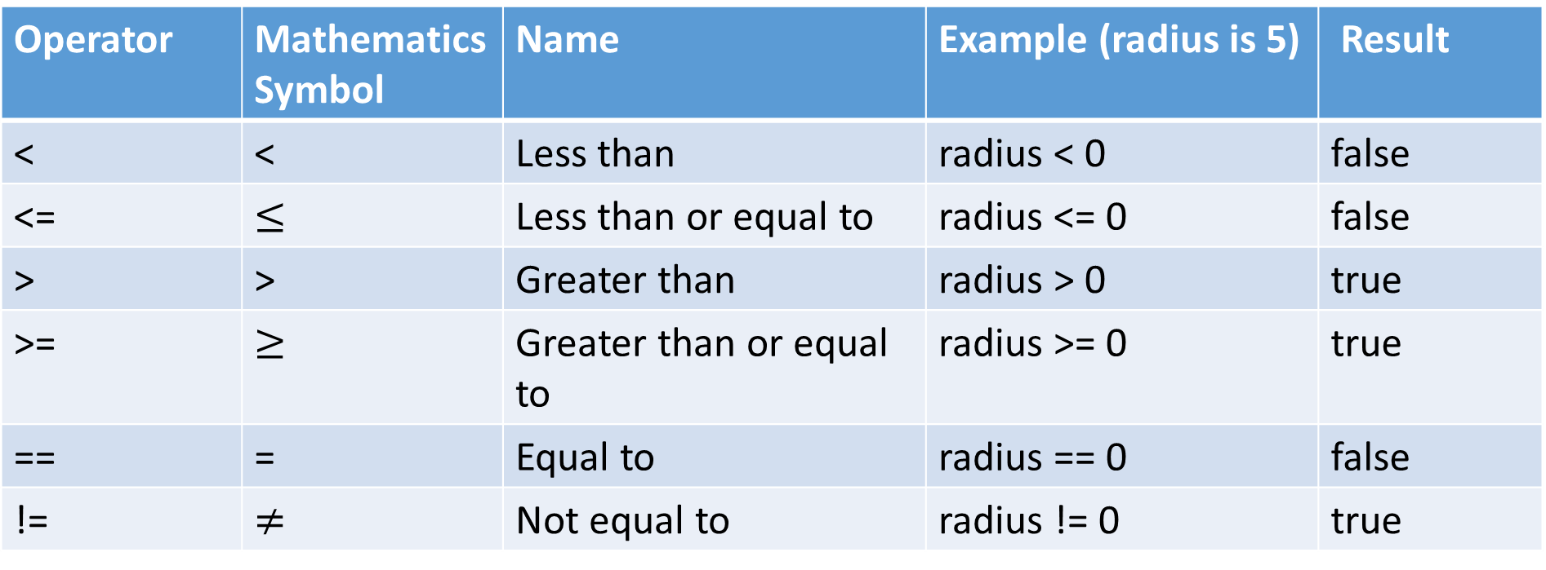
TUIT
The bool Data Type
The bool data type declares a variable with the value either true or false.
Relational Operators
Operator | Mathematics Symbol | Name | Example (radius is 5) | Result
< | < | Less than | radius < 0 | false
<= | $$≤$$ | Less than or equal to | radius <= 0 | false
> | > | Greater than | radius > 0 | true
>= | $$≥$$ | Greater than or equal to | radius >= 0 | true
== | = | Equal to | radius == 0 | false
!= | $$≠$$ | Not equal to | radius != 0 | true

Slide 6
TUIT
Boolean variable
The result of the comparison is a Boolean value: true or false. A variable that holds Boolean value is known as a Boolean variable. The bool data type is used to declare Boolean variables.
bool lightsOn = true;
cout << (4 < 5); //displays 1, because 4 < 5 is true
cout << (4 > 5); //displays 0, because 4 > 5 is false

Slide 7
TUIT
Note
The equality testing operator is two equal signs (==), not a single equal sign (=). The letter symbol is used for assignment.
In C++, you can assign a numeric value to a bool variable. Any nonzero value evaluates to true and zero value evaluates to false.
bool b1 = -1.5; // Same as bool b1 = true
bool b2 = 0; // Same as bool b2 = false
bool b3 = 1.5; // Same as bool b3 = true

Slide 8
TUIT
Check Point
Assuming that x is 1, show the result of the following Boolean expressions:
(x > 0)
(x < 0)
(x != 0)
(x >= 0)
(x != 1)

Slide 9
TUIT
Check Point
Show the printout of the following code:
bool b = true;
int i = b;
cout << b << endl;
cout << i << endl;

Slide 10

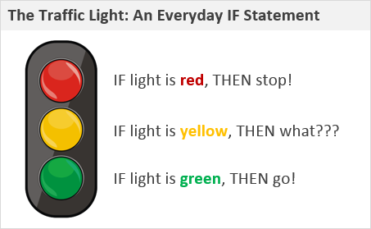
TUIT
If Statements
An if statement is a construct that enables a program to specify alternative path of execution.
C++ provides several types of selection statements: one-way if statements, two-way if-else statements, nested if statements, switch statements, and conditional expressions.

Slide 11
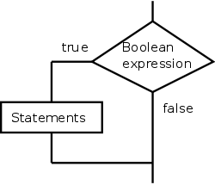
TUIT
One-way if statements
The syntax for a one-way if statement is shown here:
if (boolean–expression)
{
statement(s);
}

Slide 12
TUIT
One-way if statements
If the Boolean-expression evaluates to true, the statements in the block are executed.
if (radius > 0)
{
area = radius * radius * 3.14159;
cout << "The area for the circle of radius " << radius << " is " << area <<endl;
}

Slide 13
TUIT
One-way if statements
The boolean – expression is enclosed in parentheses.
if i > 0 { cout << “i is positive” << endl; }
if (i > 0) { cout << “i is positive” << endl; }
wrong
correct

Slide 14
TUIT
One-way if statements
The braces can be omitted if they enclose a single statement.
if (i > 0) { cout << “i is positive” << endl; }
if (i > 0) cout << “i is positive” << endl;
Equivalent

Slide 15
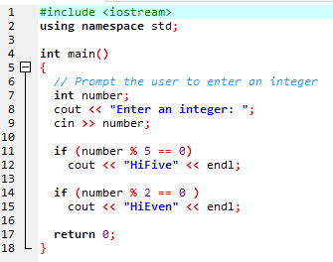


TUIT
One-way if statements
Enter an integer: 4 HiEven
Enter an integer: 30 HiFive HiEven

Slide 16
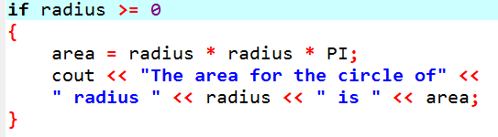
TUIT
Check Point
What is wrong in the following code?

Slide 17
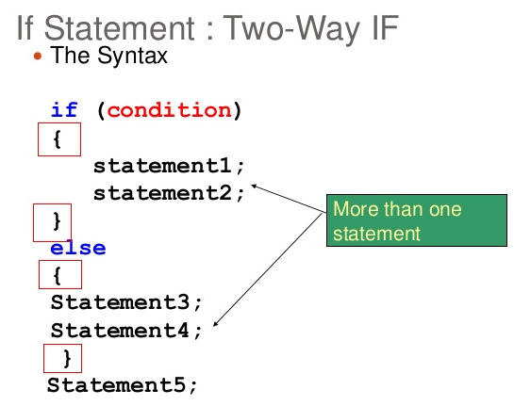
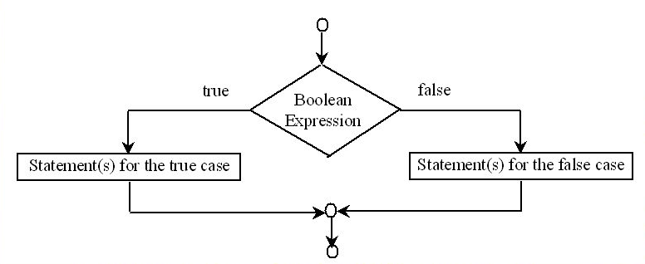
TUIT
Two-Way if-else Statements
An if – else statement decides which statements to execute based on whether the condition is true or false.

Slide 18
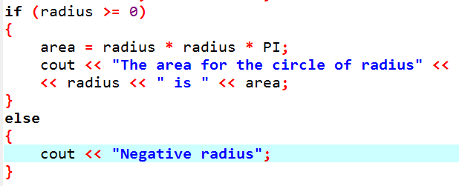
TUIT
Two-Way if-else Statements

Slide 19
TUIT
Check Point
What is the printout of the code in (a) and (b) if number is 30? What if number is 35 ?
if (number % 2 == 0)
cout << number << “ is even.” << endl;
cout << number << “is odd.” << endl;
if (number % 2 == 0)
cout << number << “ is even.” << endl;
else
cout << number << “ is odd.” << endl;
(a)
(b)

Slide 20
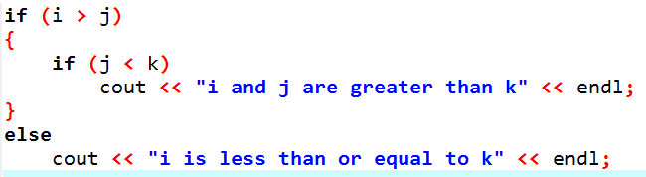
TUIT
Nested if and Multi-Way if – else Statements
An if statement can be inside another if statement to form a nested if statement.

Slide 21
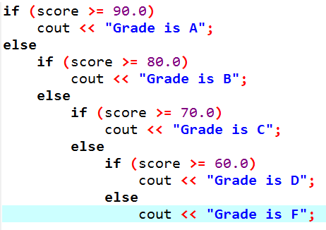
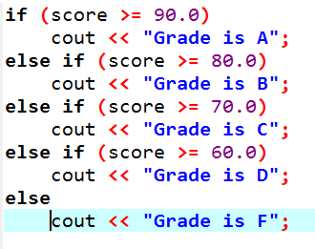
TUIT
Nested if and Multi-Way if – else Statements
Assigns a letter grade to the variable grade according to the score, with multiple alternatives.
Equivalent
This is better

Slide 22
TUIT
Nested if and Multi-Way if – else Statements
false
score>-=90
true
false
score>-=80
Grade is A
false
true
score>-=70
Grade is B
false
true
score>-=60
Grade is C
Grade is F
true
Grade is D

Slide 23
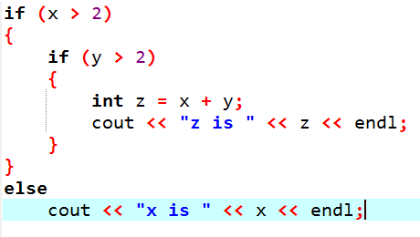
TUIT
Check Point
Suppose x = 2 and y = 3; show the output, if any, of the following code. What is the output if x = 3 and y = 4? What is the output if x = 2 and y = 2? Draw a flowchart of the code.

Slide 24
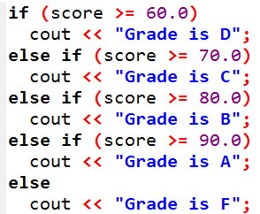
TUIT
Check Point
What is the wrong in the following code?

Slide 25


TUIT
Common Errors and Pitfalls
Forgetting necessary braces, misplacing semicolons in an if statement, mistaking == for =, and dangling else clauses are common errors in selection statements. Duplicated statements in if-else statements and testing equality of double values are common pitfalls.

Slide 26
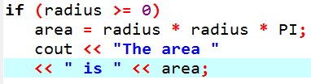
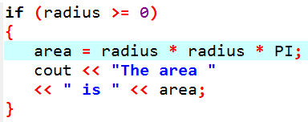
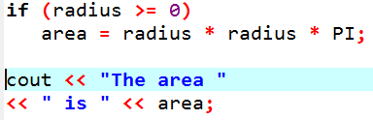
TUIT
Common Error 1
Forgetting necessary braces.
(a) Wrong
(b) Correct

Slide 27
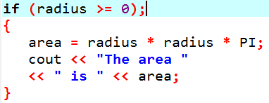
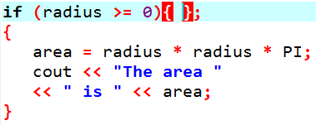
TUIT
Common Error 2
Wrong semicolon at the if line
Logic error
Empty body

Slide 28
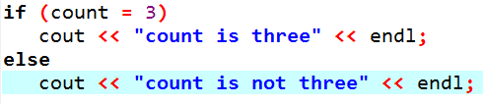
TUIT
Common Error 3
Mistakenly Using = for ==
It always displays “count is three”.

Slide 29
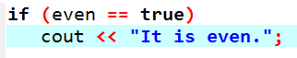
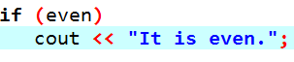
TUIT
Common Error 4
Redundant Testing of Boolean values.
This is better

Slide 30
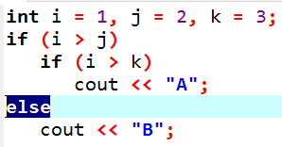
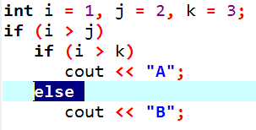
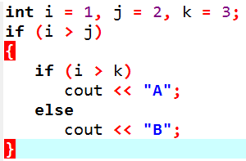
TUIT
Common Error 5
Dangling else Ambiguity
Equivalent
This is better
with correct
indentation

Slide 31
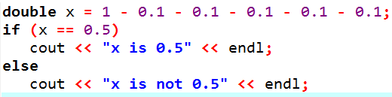
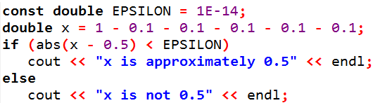
TUIT
Common Error 6
Equality Test of two floating – point values

Slide 32
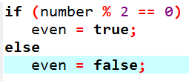
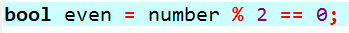
TUIT
Common Pitfall 1
Simplifying Boolean Variable Assignment
This is better

Slide 33
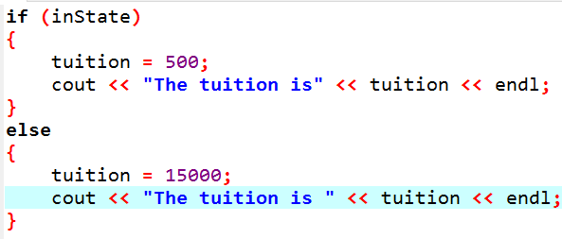
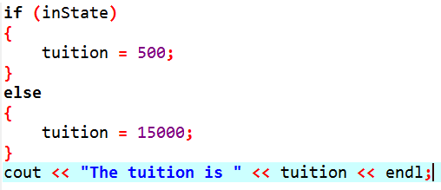
TUIT
Common Pitfall 2
Avoiding Duplicate Code in Different Cases
They are not error they are equal but second is better!

Slide 34
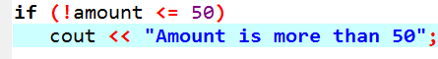

TUIT
Common Pitfall 3
Integer values can be used as Boolean values

Slide 35
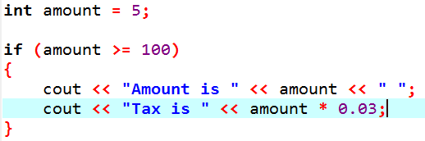
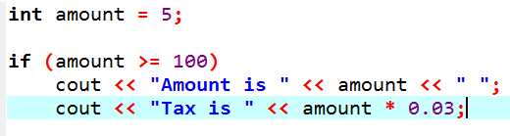
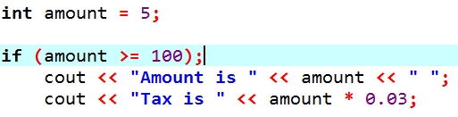
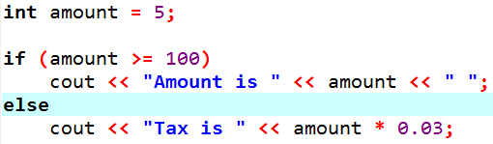
TUIT
Check Point
Show the output of the following code:
(a)
(b)
(c)
(d)

Slide 36
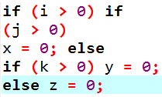
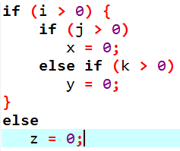
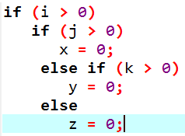
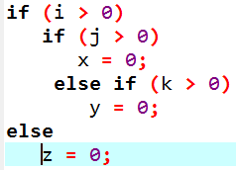
TUIT
Check Point
Which of the following statements are equivalent? Which ones correctly indented?
(a)
(b)
(c)
(d)

Slide 37
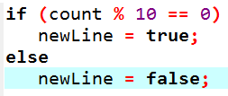
TUIT
Check Point
Rewrite the following statement using a Boolean expression:

Slide 38
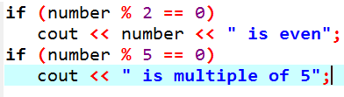
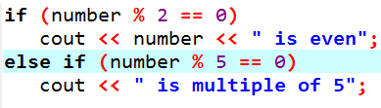
TUIT
Check Point
What is the output of the following code if number is 14, 15, and 30?
(a)
(b)

